Slide 1
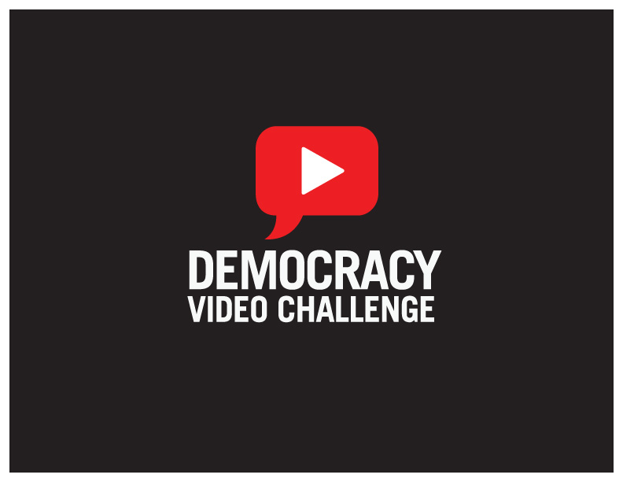
hello

Slide 2
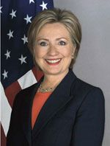
“We are working at the State Department to ensure that our government is using the most innovative technologies not only to speak and listen across borders,
not only to keep technologies up and going, but to widen opportunities especially for those who are too often left on the margins.”
-Secretary of State Hillary Rodham Clinton, Foreign Policy Address at the Council on Foreign Relations, July 15, 2009

Slide 3
Public Diplomacy
Engage, inform and influence foreign audiences in discussions about topics that are central to U.S. interests.
How do we use Web 2.0 technologies to pursue this goal?

Slide 4
Democracy Video Challenge
Challenge young filmmakers, democracy advocates and citizens from around the world to share their views on democracy in an online global dialogue through video and web 2.0 technologies.

Slide 5
Credibility & Incentive
They won’t care what I have to say…
We faced two central questions:
How do we build credibility?

Slide 6
Credibility & Incentive
They won’t care what I have to say…
We faced two central questions:
How do we build credibility?
What is the incentive for our audience?
Why spend my time on this?

Slide 7














Credibility:
Global Partners
Film/Media/Entertainment
Democracy
Academia
Youth
U.S. Government

Slide 8
Benefits of Partnership
  Contest video platform
  Elements of the prize package
  Global marketing support
  An independent jury
  Net effect: collectively achieving more than any individual organization on its own

Slide 9
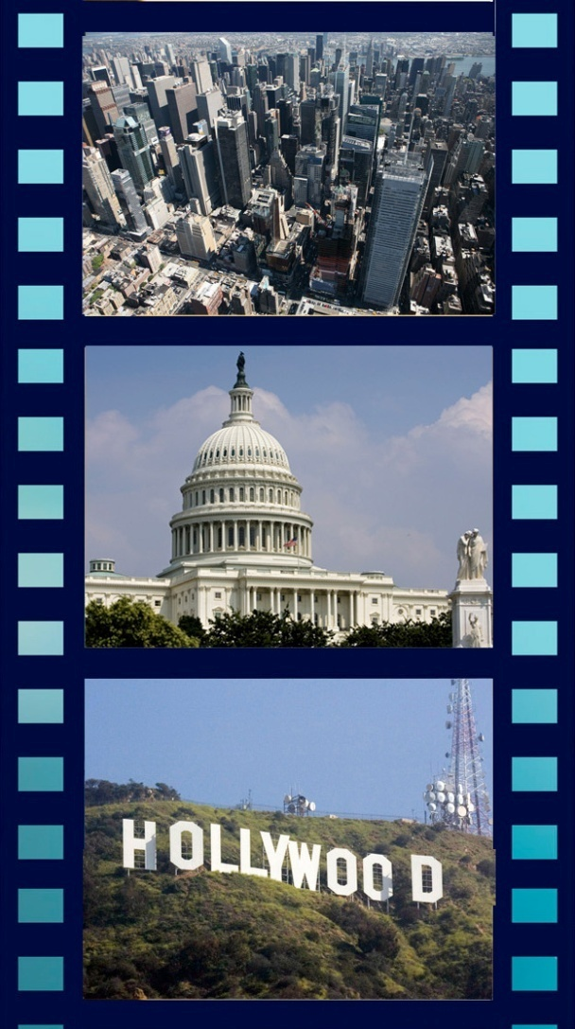
Incentive: The Prize
All-expense-paid trip to New York, Washington, D.C., and Hollywood
Exposure to film professionals
Professional development in film arts, technology and social media
Networking with democracy advocates, media and civil society

Slide 10
How it Worked
Users submit 3-minute videos that complete the phrase:
“Democracy is…”

Slide 11
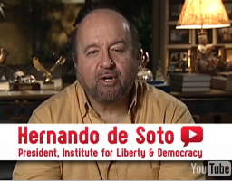
Jury
An independent panel of 50 jurors—
co-chaired by internationally
renowned leaders from the film industry and democracy community—choose the finalists…
With general rules:
No profanity, graphic violence, copyrighted material, etc.
You Tube’s terms of use
And judging criteria:
Overall impact
Creativity
Production

Slide 12
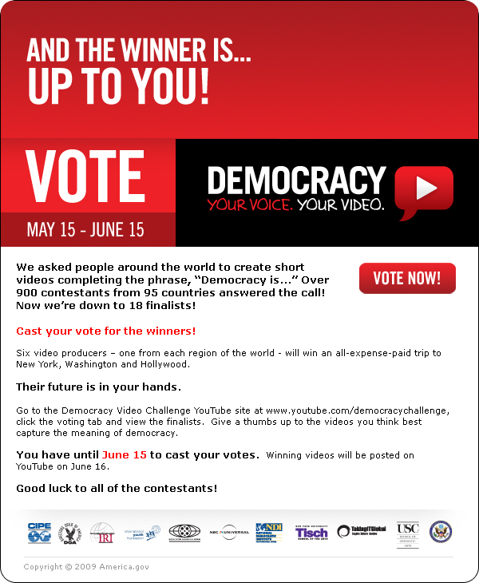
Voting
The YouTube public
selects the winners

Slide 13
Outcomes
By the Numbers
900+ Video submissions from 95 countries
Over 500 million impressions since September 2008
More than 1.5 million global viewers to contest
10,000+ fans, friends and followers online

Slide 14
Outcomes
Engagement
Visual:
  Provided a thought provoking global tour of democracy in compelling and creative three-minute “snippets”
  A conversation:
  Formed the foundation for Facebook and Twitter discussions on film and the broader concept of democracy

Slide 15
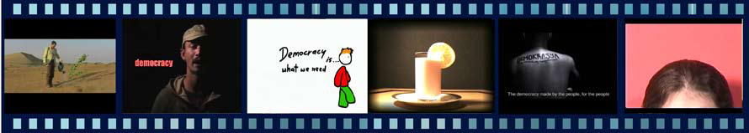
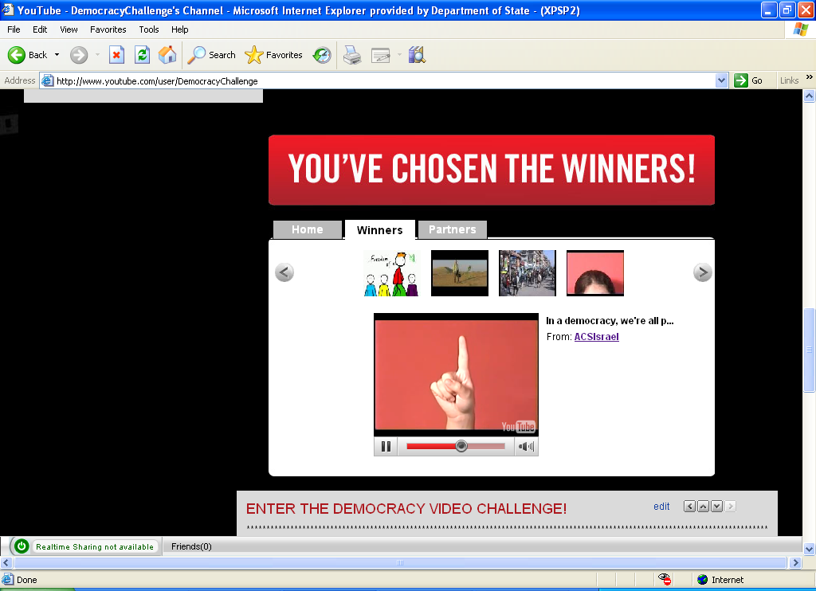
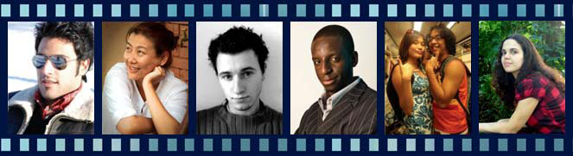
2009 Winners
Visual
UAE | Nepal | Poland | Zambia | Philippines | Brazil

Slide 16
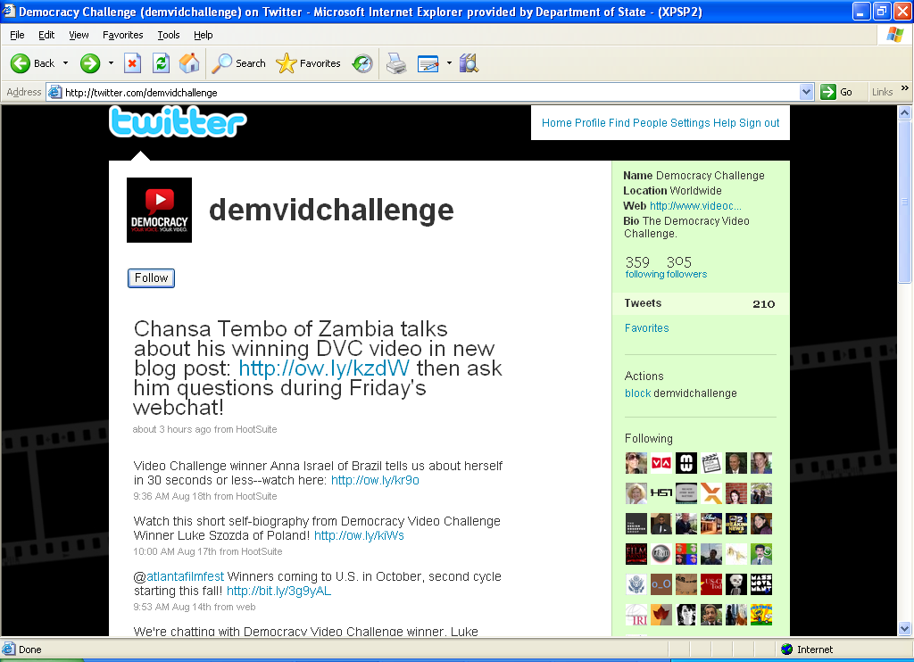
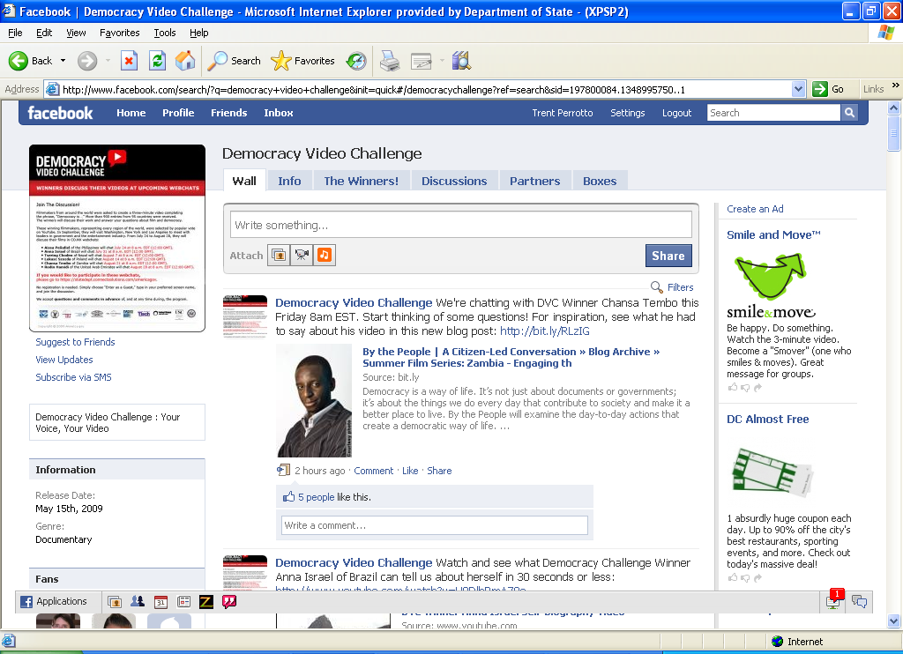
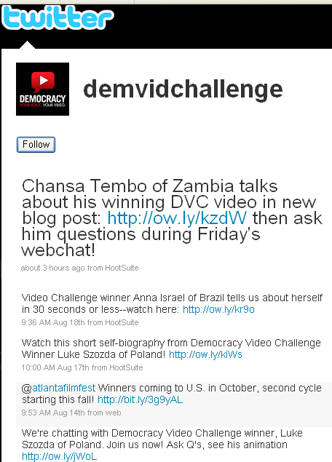
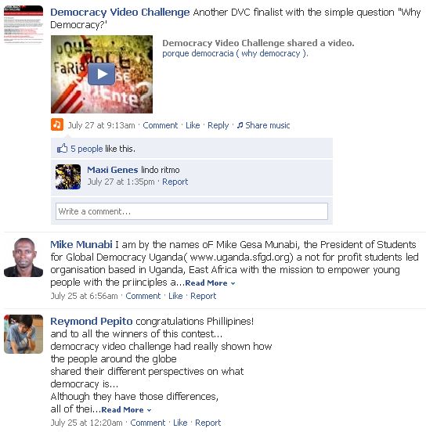
Conversation
Hillary visits Africa
Obama talks in Egypt

Slide 17
Lessons Learned
Balance user-generated content and editorial control
Be transparent: Explain what you’re doing
Respect your partners
Know your new media
(and its limitations)

Slide 18
Going Forward
Do it again:
Launch the Second annual challenge at the UN on September 15 – The International Day of Democracy

Slide 19
Going Forward
Keep the energy going:
Find ways for winners and participants to continue the global dialogue on democracy

Slide 20
For more information, please visit
www.videochallenge.america.gov

